Slide 1
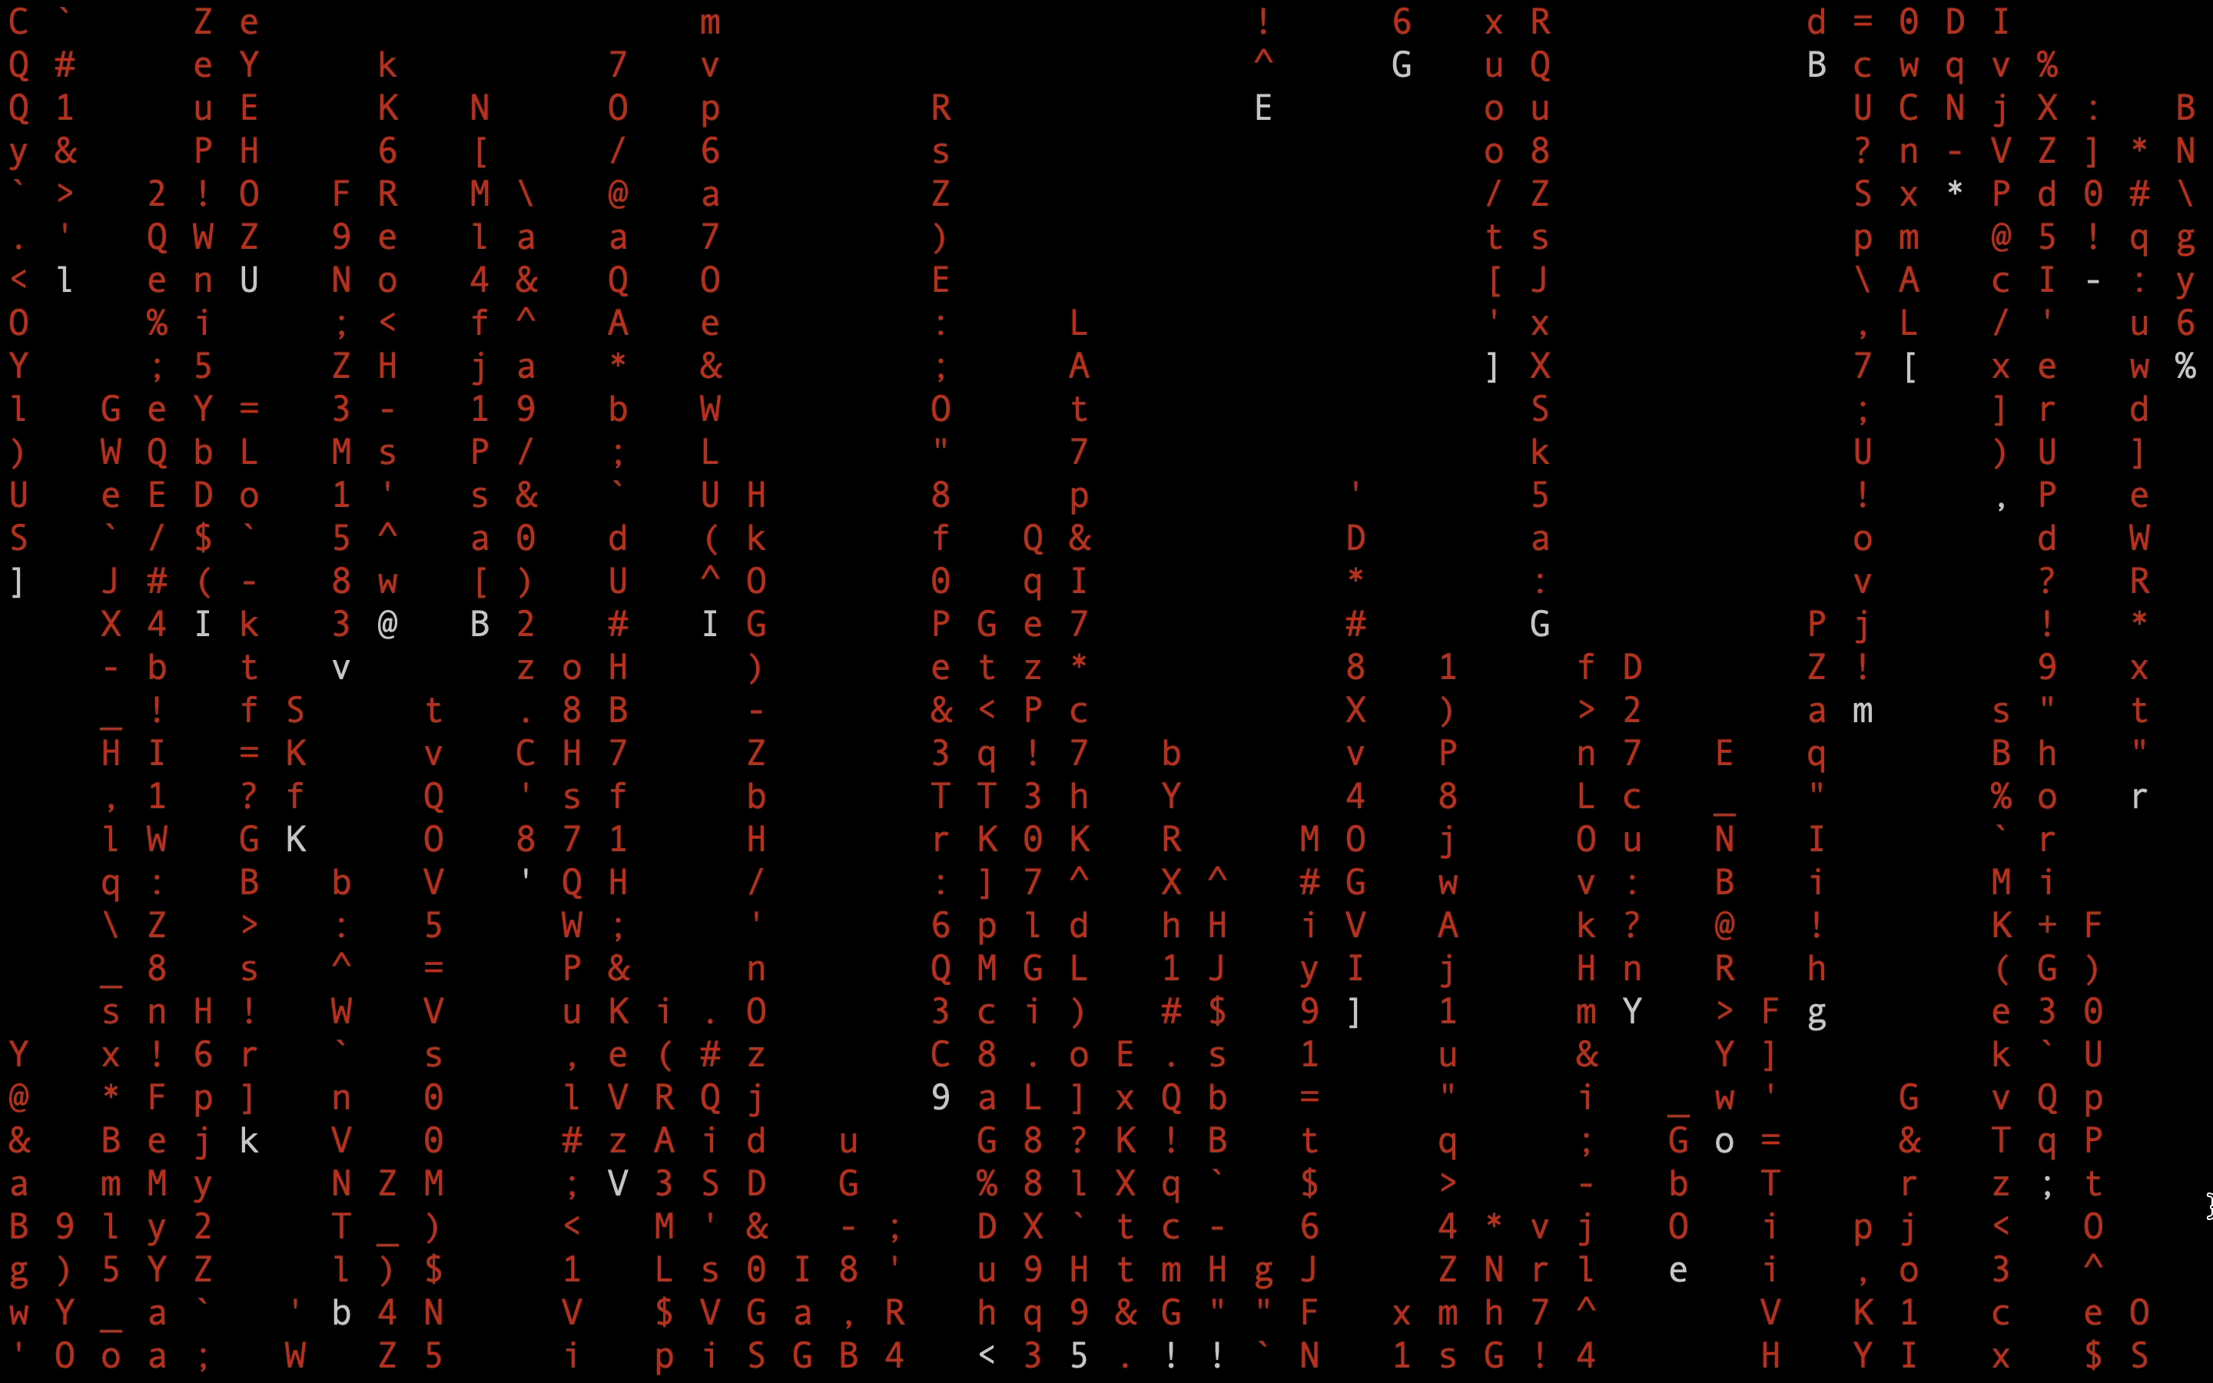

Group - 11
BHARAT DNS

Slide 2
Group - 11
BHARAT DNS

Slide 3
BHARAT DNS
eyond
Ighly
Dvanced
esilient
nd
hreat-resistant
Omain
ame
ervice

Slide 4
Introduction
Agenda – DNS Filtering service using AI/ML techniques
The Domain Name System serves as the backbone of the internet, facilitating the seamless translation of human-readable domain names into machine-readable IP addresses
Project Description – enhancing cybersecurity by -
blocking malicious domains for fast, secure DNS resolution. Key
features include:
• Malicious site blocking
• AI/ML-based threat detection
• DNS tunneling prevention
• Support for multiple DNS protocols
Despite its fundamental role in internet communication, DNS is not immune to exploitation by malicious sources seeking to infiltrate networks, compromise data integrity, or launch cyberattacks
• Scalability and low latency
• DNS caching for improved resolution
• Active and passive analysis
• User-friendly web interface for real-time monitoring and
reporting.
Our goal is to strengthen cybersecurity and provide users with effective tools for safe navigation through the digital realm by tackling the challenges and vulnerabilities in DNS resolution

Slide 5
Introduction
Overview
The Domain Name System serves as the backbone of the internet, facilitating the seamless translation of human-readable domain names into machine-readable IP addresses
Despite its fundamental role in internet communication, DNS is not immune to exploitation by malicious sources seeking to infiltrate networks, compromise data integrity, or launch cyberattacks
Our goal is to strengthen cybersecurity and provide users with effective tools for safe navigation through the digital realm by tackling the challenges and vulnerabilities in DNS resolution
Whenever a user enters a domain name, there are three possible paths it can take:
Whitelist: The domain name has already been classified as safe and hence is immediately resolved into its corresponding IP Address. This ensures seamless access to trusted resources without the need for further verification.
Blacklist: If the domain name has been flagged as malicious or unsafe by network administrators, it is immediately blocked and not resolved.
ML Model: When encountering a domain name for the first time, our system employs a custom machine learning model based on TensorFlow Keras to assess the domain's safety, identifying potential threats such as DNS tunneling. If the domain is deemed safe, it is added to the whitelist, and DNS resolution proceeds accordingly.

Slide 6
Introduction
Whitelist
Overview
On initial startup , the whitelist consists of a few known entities that are classified as safe , example : “google.com” , “fb.com” , etc.
As the program runs and handles more DNS requests, all domains that are successfully resolved are added to the whitelist since they are considered safe.
Consequently, they do not need to be sent through the ML loop when encountered again. This ensures that the most common requests are resolved immediately while also ensuring the system operates safely and effectively.
Whenever a user enters a domain name, there are three possible paths it can take:
Whitelist: The domain name has already been classified as safe and hence is immediately resolved into its corresponding IP Address. This ensures seamless access to trusted resources without the need for further verification.
Blacklist: If the domain name has been flagged as malicious or unsafe by network administrators, it is immediately blocked and not resolved.
ML Model: When encountering a domain name for the first time, our system employs a custom machine learning model based on TensorFlow Keras to assess the domain's safety, identifying potential threats such as DNS tunneling. If the domain is deemed safe, it is added to the whitelist, and DNS resolution proceeds accordingly.
The Domain Name System serves as the backbone of the internet, facilitating the seamless translation of human-readable domain names into machine-readable IP addresses.
Despite its fundamental role in internet communication, DNS is not immune to exploitation by malicious sources seeking to infiltrate networks, compromise data integrity, or launch cyberattacks.
Our goal is to strengthen cybersecurity and provide users with effective tools for safe navigation through the digital realm by tackling the challenges and vulnerabilities in DNS resolution.

Slide 7
Overview
Whitelist
Blacklist
On initial startup , the whitelist consists of a few known entities that are classified as safe , example : “google.com” , “fb.com” , etc.
As the program runs and handles more DNS requests, all domains that are successfully resolved are added to the whitelist since they are considered safe.
Consequently, they do not need to be sent through the ML loop when encountered again. This ensures that the most common requests are resolved immediately while also ensuring the system operates safely and effectively.
There are invariably certain sites that are restricted by the system administrator, potentially due to various reasons such as being deemed unsafe, blocked by governmental regulations, or for other security concerns.
All of these restricted sites are cataloged within the system's blacklist.
If the entered domain name is not found in the whitelist, the subsequent step involves checking the blacklist.
Should the domain be identified in the blacklist, the resolution process is promptly terminated. Conversely, if the domain is not listed in the blacklist, the system proceeds to the ML Model check to ascertain its safety status.
Whenever a user enters a domain name, there are three possible paths it can take:
Whitelist: The domain name has already been classified as safe and hence is immediately resolved into its corresponding IP Address. This ensures seamless access to trusted resources without the need for further verification.
Blacklist: If the domain name has been flagged as malicious or unsafe by network administrators, it is immediately blocked and not resolved.
ML Model: When encountering a domain name for the first time, our system employs a custom machine learning model based on TensorFlow Keras to assess the domain's safety, identifying potential threats such as DNS tunneling. If the domain is deemed safe, it is added to the whitelist, and DNS resolution proceeds accordingly.

Slide 8
Whitelist
On initial startup , the whitelist consists of a few known entities that are classified as safe , example : “google.com” , “fb.com” , etc.
As the program runs and handles more DNS requests, all domains that are successfully resolved are added to the whitelist since they are considered safe.
Consequently, they do not need to be sent through the ML loop when encountered again. This ensures that the most common requests are resolved immediately while also ensuring the system operates safely and effectively.
Blacklist
There are invariably certain sites that are restricted by the system administrator, potentially due to various reasons such as being deemed unsafe, blocked by governmental regulations, or for other security concerns.
All of these restricted sites are cataloged within the system's blacklist.
If the entered domain name is not found in the whitelist, the subsequent step involves checking the blacklist.
Should the domain be identified in the blacklist, the resolution process is promptly terminated. Conversely, if the domain is not listed in the blacklist, the system proceeds to the ML Model check to ascertain its safety status.

Slide 9
ML Model
Database
If the domain name is not found in either the whitelist or blacklist, it signifies that the system encounters it for the first time. Hence, it is passed through the ML Model for evaluation.
The ML Model, based on Neural Network algorithms in TensorFlow Keras is designed to test whether DNS Tunnelling and other malicious elements are present in the domain name passed to the system.
The model we’ve created is capable of detecting DNS Tunnelling with 99.96% accuracy.
The training set for the model was split 52 : 48 in terms of malicious and non malicious queries.
Our database and authentication runs on Firebase Realtime Database.
The database consists of various parameters :
Query Name : Input sent to service
Client Address : Address from which request was received
Resolved IP : Output IP Address
Time of Request : Time at which request was sent
Elapsed Time : Time taken to resolve IP
Boolean parameters signifying where the request was handled
Whitelist
Blacklist
Malicious

Slide 10
Database
ML Model
Our database and authentication runs on Firebase Realtime Database.
The database consists of various parameters :
Query Name : Input sent to service
Client Address : Address from which request was received
Resolved IP : Output IP Address
Time of Request : Time at which request was sent
Elapsed Time : Time taken to resolve IP
Boolean parameters signifying where the request was handled
Whitelist
Blacklist
Malicious
If the domain name is not found in either the whitelist or blacklist, it signifies that the system encounters it for the first time. Hence, it is passed through the ML Model for evaluation.
The ML Model, based on Neural Network algorithms in TensorFlow Keras is designed to test whether DNS Tunnelling and other malicious elements are present in the domain name passed to the system.
The model we’ve created is capable of detecting DNS Tunnelling with 99.96% accuracy.
The training set for the model was split 53 : 47 in terms of malicious and non malicious queries.

Slide 11








Security
Agenda – DNS Filtering service using Threat Intelligence System and
AI/ML techniques
Technology stack:
Python for AI/ML components
PowerDNS (Open-source DNS server software)
HTML, CSS, JavaScript, React, MongoDB
TensorFlow, scikit-learn
Linux-based servers
The database consists of robust security rules to ensure that nobody can tamper with it.
Access to the database is categorized into two groups:
Superadmins: Comparable to network administrators, they are responsible for creating and managing the service. Superadmins possess exclusive write access to the database.
Admins: Users who operate or oversee the service. They are granted read-only access to the database.
Any user not belonging to these designated groups will be automatically denied access to the database , and will be allowed to use only the DNS Filtering Service.
Prior to starting the BharatDNS software, superadmins must login using their userID and password.
Authentication is handled by Firebase.
Project Description – enhancing cybersecurity by -
blocking malicious domains for fast, secure DNS resolution. Key
features include:
• Threat intelligence integration
• AI/ML-based threat detection
• DNS tunneling prevention
• Support for multiple DNS protocols
• Scalability and low latency
• DNS caching for improved resolution
• Active and passive analysis
• User-friendly web interface for real-time monitoring and
reporting.

Slide 12
Technology stack:
Python for AI/ML components
PowerDNS (Open-source DNS server software)
HTML, CSS, JavaScript, React, MongoDB
TensorFlow, scikit-learn
Linux-based servers

Slide 13
Use Cases:
Enterprise Network Security
Educational Institutions
Financial Institutions
Government Agencies
Managed Security Service Providers (MSSPs)
Large Corporations with Remote Workers
Internet Service Providers (ISPs)
Cybersecurity Research and Threat Analysis
Security Operations Centers (SOCs)
Home Network Security
Dependencies/stopper:
Keeping threat intelligence feeds up-to-date.
Continuous model training for AI/ML.
Scalability under high query loads.

Slide 14
Team Members:
Sarthak Gupta – ReactJS and DNS Resolution
Dhanush Hebbar – OS and Parallel Processing
Arjun R. Nair – DNS Resolution and Frontend
Rohit Paul Reddy – TAXII Server and STIX Protocol
Late. Y. Chandrashekhar Rao – Pcap Analysis Integration

